Slide 1


Reactivity of non-ferrous metallurgical slags and sludges measured by the RILEM R3 test
Ruben Snellings, Hadi Kamyab
EUROPEAN UNION
This project has received funding from the European Union’s Horizon 2020 research and innovation programme under grant agreement No 690088.

Slide 2
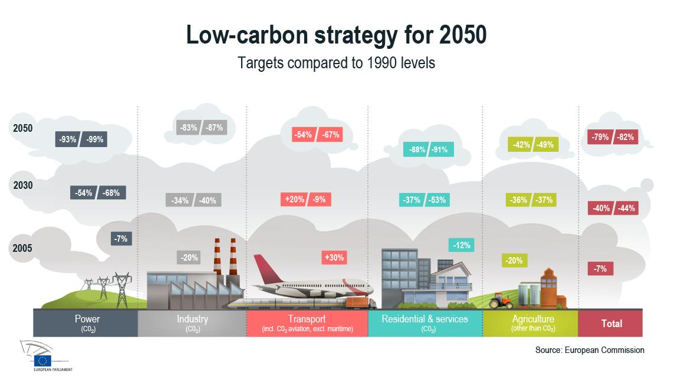
Abating Climate Change
Global cement production ± 4.2 Gton / 8-10 % of global CO₂ emissions
If no actions are taken cement related emissions may increase up to 25% by 2050

Slide 3
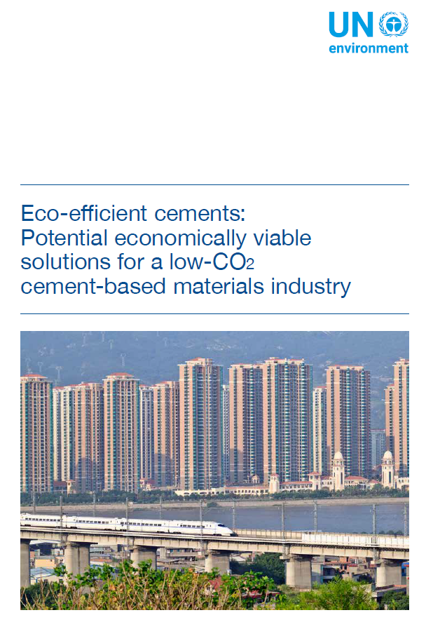
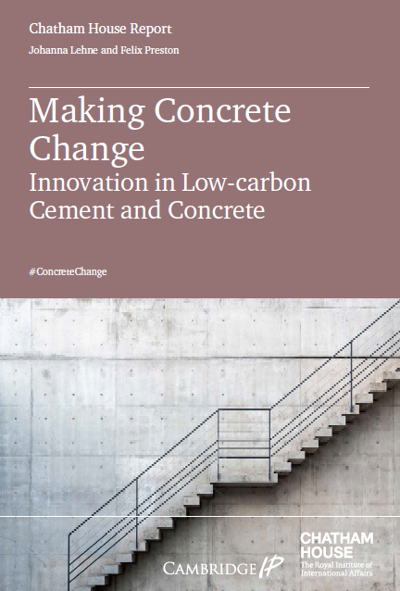

Public awareness and Pressure is Rising
UNEP, 2017
Chatham House, 2017
European Climate Foundation, 2018

Slide 4
SCMs and cement CO₂
Ordinary Portland cement consists of Portland clinker (95%) and Ca-sulfate (5%)
  Portland clinker is produced by firing a raw meal of limestone and clay at 1450 °C
  Portland clinker consists mainly of calcium silicates (C₃S, C₂S), calcium aluminate (C₃A) and ferrite (C₄AF)
Production of 1 tonne of clinker emits around 0.9 tonne of CO₂
  60% of the emissions result from decarbonation of limestone, 40% from the process
Options for reducing CO₂ emissions
  Modern kilns are at thermodynamic limit in terms of efficiency (little margin)
  Co-processing of waste fuels – offer is limited / little improvement possible
  Replacement of clinker by SCMs, i.e. iron blast furnace slag, coal combustion fly ash etc.
  CCS/CCU – technical/economic feasibility highly uncertain (large investments)

Slide 5
SCMs and cement CO₂
Ordinary Portland cement consists of Portland clinker (95%) and Ca-sulfate (5%)
  Portland clinker is produced by firing a raw meal of limestone and clay at 1450 °C
  Portland clinker consists mainly of calcium silicates (C₃S, C₂S), calcium aluminate (C₃A) and ferrite (C₄AF)
Production of 1 tonne of clinker emits around 0.9 tonne of CO₂
  60% of the emissions result from decarbonation of limestone, 40% from the process
Options for reducing CO₂ emissions
  Modern kilns are at thermodynamic limit in terms of efficiency (no margin)
  Co-processing of waste fuels – offer is limited / little improvement possible
  Replacement of clinker by SCMs, i.e. iron blast furnace slag, coal combustion fly ash etc.
  CCS/CCU – technical/economic feasibility highly uncertain (large investments)

Slide 6
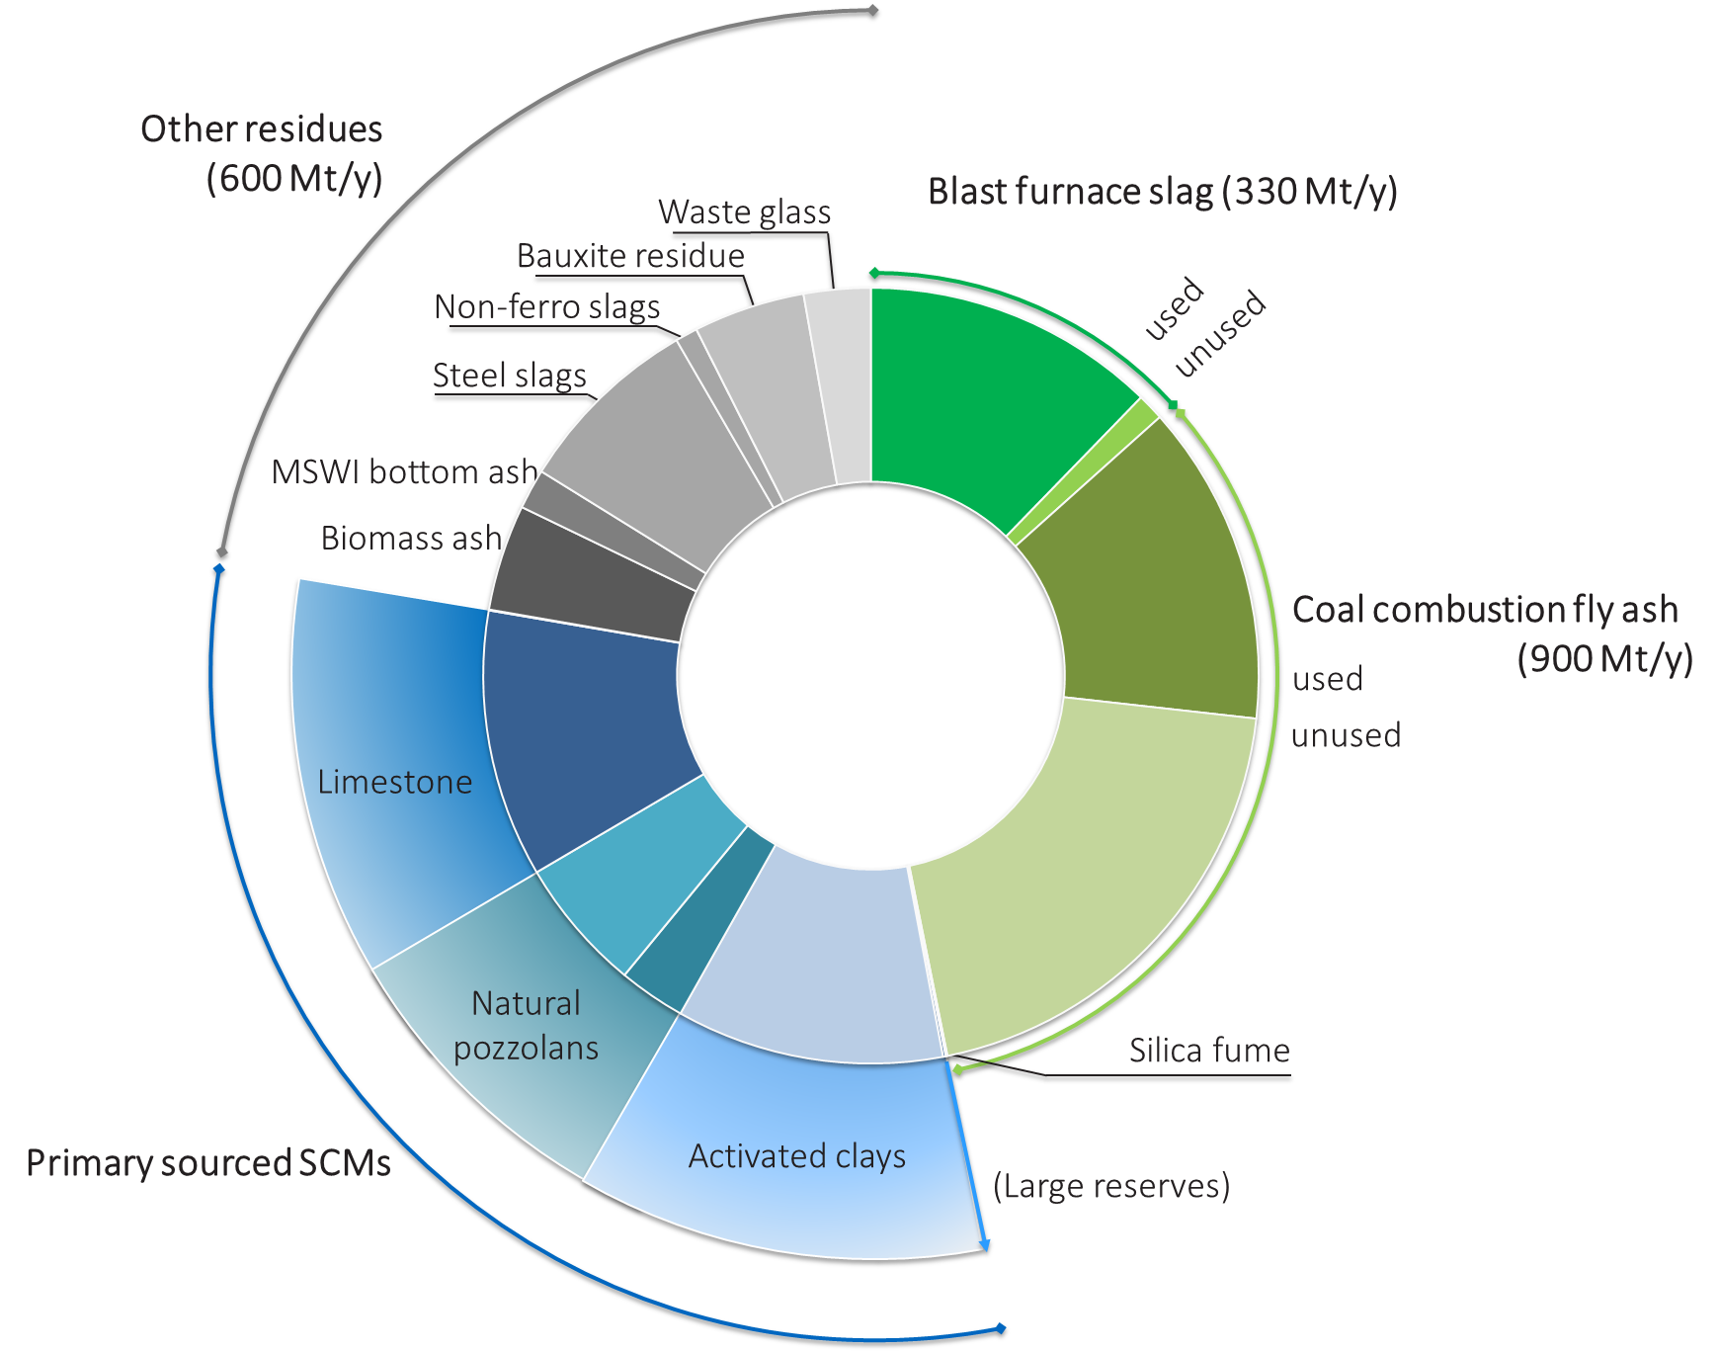
Challenges and opportunities for Use of SCMs in blended cements
Challenge
  Most conventional, high-quality SCMs are fully used
  Changes in energy sector and increased steel recycling will further reduce available volumes of conventional SCMs
Opportunities
Increased use of primary sourced SCMs (limestone, natural pozzolans, calcined clays)
Improve the quality of unused conventional SCMs (fly ashes…)
Resolve challenges and create opportunities for use of «other residues»
[Main sources: USGS, CSI-GNR, UNEP, IAI]
Notes:
.

Slide 7
Challenges and opportunities for Use of SCMs in blended cements
Challenge
  Most conventional, high-quality SCMs are fully used
  Changes in energy sector and increased steel recycling will further reduce available volumes of conventional SCMs
Opportunities
Increased use of primary sourced SCMs (limestone, natural pozzolans, calcined clays)
Improve the quality of unused conventional SCMs (fly ashes…)
Resolve challenges and create opportunities for use of «other residues»
[Main sources: USGS, CSI-GNR, UNEP, IAI]
Notes:
.

Slide 8
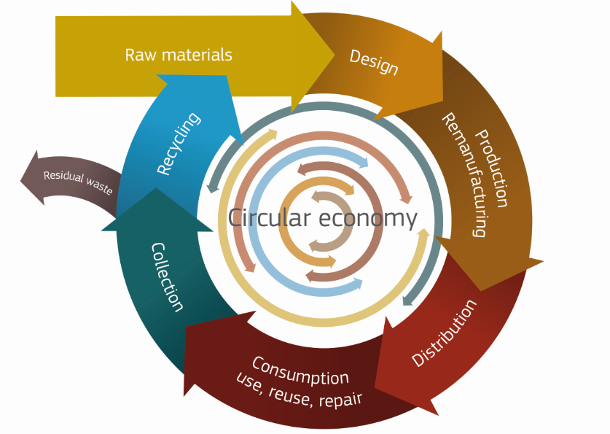
Reactivity as key to performance
SCM reactivity is key
  (Early age) strength development
  Microstructure development
  Durability
How to tailor reactivity?
  Grinding/milling
  Thermal activation
  Chemical activation (pH, counter-anion)
[EC, 2014]
Notes:
Screening of incoming raw materials
Binder design and optimisation
Quality control

Slide 9
RILEM TC 267 TRM – Tests for reactivity of SCMs
Background
  Generally perceived lack of reliable and relevant test methods in standards to rapidly assess the reactivity of a wide range of SCMs
  Variety of promising tests being used/developed in a number of laboratories (a.o. calorimetry, chemical shrinkage, bound water content)
Scope
  Evaluation of the most promising new methods across a wide range of SCMs and comparing these to existing reactivity test methods
Main outcomes
  Pre-standard for reactivity testing of SCMs designed to correlate with strength development and to include slags and combinations of SCMs in addition to pure pozzolans
  Knowledge transfer and communication of findings to research and standardisation communities

Slide 10
RILEM TC TRM – Tests for reactivity of SCMs
Work plan
  Phase 1 (2016-2017): Comparison of new and existing test methods against mortar compressive strength benchmark
  Phase 2 (2017-2019): Optimisation and robustness of best performing test methods
  Phase 3 (2019-2020): Validation across wide range of SCMs
  Gantt chart
 | 2016 |  |  | 2017 |  |  |  | 2018 |  |  |  | 2019 |  |  |  | 2020
 | Q2 | Q3 | Q4 | Q1 | Q2 | Q3 | Q4 | Q1 | Q2 | Q3 | Q4 | Q1 | Q2 | Q3 | Q4 | Q1 | Q2 | Q3
Phase 1 Exp
Phase 2 parameters
Phase 2 robustness
Phase3
Finalization

Slide 11
Phase 1 – Materials and methods
22 participant institutes
11 SCMs tested: siliceous and calcareous fly ash; GGBFS, natural pozzolans, calcined clays, milled quartz,…
10 testing methods
72 tests across 11 SCMs = 792 individual experiments

Slide 12
Phase 1 – Pozzolanic reactivity tests
Correlation plots between relative strength and reactivity test results
Tests are evaluated based on robustness (variability of results) and correlation to strength

Slide 13
Overall evaluation of reactivity test methods
Methods | Correlation to 28d relative strength^{(a)} | Coefficient of variation | Time |  | Equipment investment | Key equipment
 |  |  | Operating | Test duration
Units | -- | % | Hours | days | relative^{(c)} | --
R³ calorimetry 7 days | 0.94 | 20.9 | 1 | 7 | 20 | Calorimeter
R³ calorimetry 3 days | 0.91 | 19.1 | 1 | 3 | 20 | Calorimeter
R³ bound water | 0.86 | 41.7 | 2 | 8 | 2 | Oven
R³ chemical shrinkage 3 days | 0.80 | 29.1 | 4 | 3 | 2 | Water bath
R³ portlandite consumption | 0.74 | 19.5 | 2 | 8 | 10 | TG
IS 1727 (Indian standard) | 0.62 | 18.1 | 1 | 10 | 2 | Compression testing machine
Modified Chapelle | 0.46 | 30.9 | 2 | 1 | 1 | Reflux condenser
Frattini ([CaO] reduction) | 0.31 | 73.1 | 2 | 8 | 1 | Glass, pipettes
Reactive silica | 0.31 | -- ^{(b)} | 2 | 1 | 2 | Glass, oven
Chapelle test | 0.00 | 96.6 | 2 | 1 | 1 | Reflux condenser

Slide 14
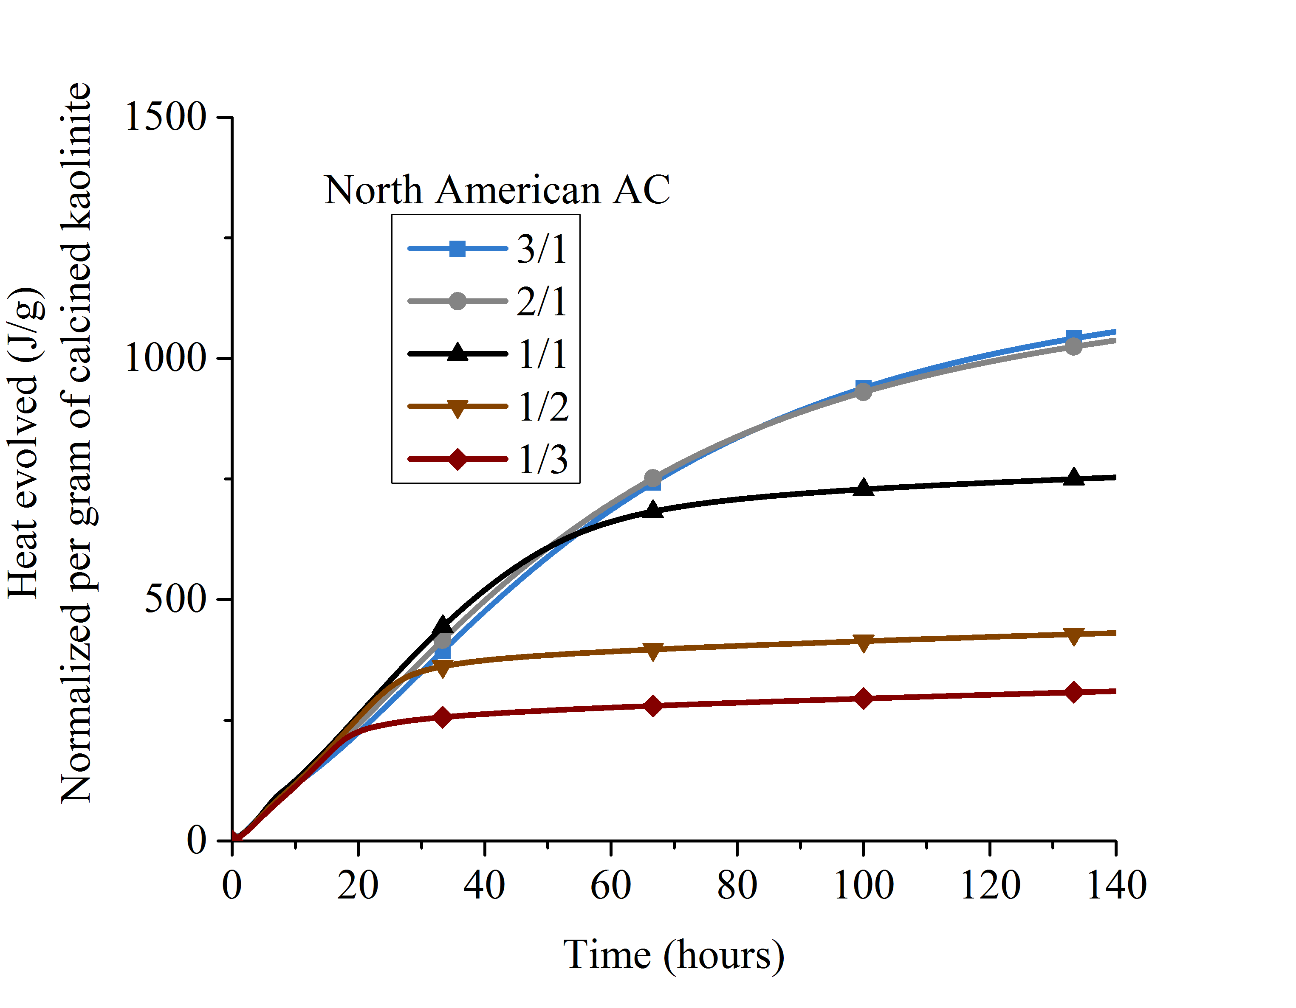
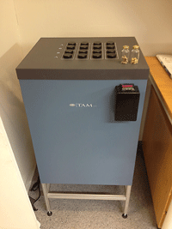
The R3 test – the method
  System
    Simplified R3 model system: SCM + Ca(OH)₂ + Cc + Alkali(sulfate)
    CH/SCM = 3:1
    Cc/SCM = 1:2
    Solution/solids = 1.23
    Solution = H₂O + KOH (4 g/L) + K₂SO₄ (20 g/L)
  Measurement
    Cumulative heat release by isothermal calorimetry
 | SCM | Ca(OH)₂ | CaCO₃ | Solution
Mass (g) | 10.00 | 30.00 | 5.0 | 54.00

Slide 15

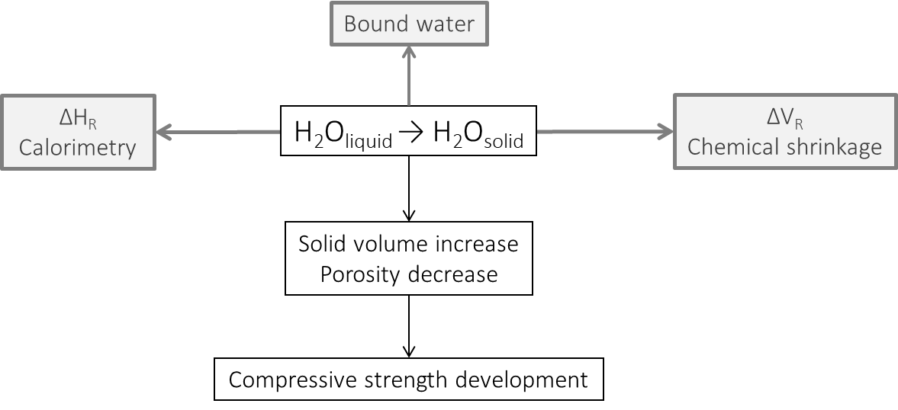
Phenomenological relationships – the H₂O link
The H₂O link

Slide 16
Some insights from Thermodynamics
Hydrate | ΔH₀^{f} | V_{m} | Formation reaction | n H₂O | ΔH₀^{f} - nΔH₀^{f}(H₂O,l) | (ΔH₀^{f} - nΔH₀^{f}(H₂O,l))/n | V_{m} reactants | ΔV₀^{R} | ΔV₀^{R}/n
 | kJ/mol | cm³/mol |  |  | kJ/mol | kJ/mol | cm³/mol | cm³/mol | cm³/mol
C₆A$₃H₃₂ | -17535 | 707 | C₃A + 3 C$ + 32 H | 32 | -9670 | -302 | 805 | -98 | -3.1
C₃AH₆ | -5537.3 | 150 | C₃A + 6 H | 6 | -1976.3 | -329 | 197 | -47 | -7.9
C₄AH₁₉ | -10017.9 | 371 | C₃A + CH + 18 H | 18 | -5471.9 | -304 | 447 | -76 | -4.2
C₄AH₁₃ | -8300.2 | 274 | C₃A + CH + 12 H | 12 | -3754.2 | -313 | 339 | -65 | -5.4
C₄A$H₁₂ | -8750 | 309 | C₃A + C$ + 12 H | 12 | -3754.4 | -313 | 352 | -43 | -3.6
C₄AcH₁₁ | -8250 | 262 | C₃A + Cc + 11 H | 11 | -3481.6 | -317 | 319 | -57 | -5.2
C₄Ac_{0.5}H₁₂ | -8270 | 285 | C₃A + 0.5 Cc + 12 H | 12 | -4105.3 | -342 | 321 | -36 | -3.0
C₂ASH₈ | -6360 | 216 | CA + S + CH + 7 H | 7 | -2199.1 | -314 | 242 | -26 | -3.8
CAH₁₀ | -5288.2 | 193 | CA + 10 H | 10 | -2961.2 | -296 | 234.6 | -42 | -4.2
C$H₂ | -2023.36 | 75 | C$ + 2 H | 2 | -588.76 | -294 | 82.12 | -7 | -3.6
CH | -985 | 33 | C + H | 1 | -350 | -350 | 34.86 | -2 | -1.9
C-S-H
C_{2/3}SH_{1.5} | -1841.5 | 55 | 2/3 CH + S + 0.833 H | 0.833 | -336.59 | -404 | 66.02198 | -11 | -13.2
C_{5/6}S_{2/3}H_{1.83} | -1742.4 | 48 | 5/6 CH + 2/3 S + H | 1 | -356.5276 | -357 | 64.863 | -17 | -16.9
C_{1.33}SH_{2.17} | -2506.3 | 76 | 1.33 CH + S + 0.84 H | 0.84 | -347.35 | -414 | 88.0604 | -12 | -14.4
C_{1.5}S_{0.67}H_{2.5} | -2400.7 | 81 | 1.5 CH + 0.67 S + H | 1 | -354.437 | -354 | 86.99 | -6 | -6.0

Slide 17
the H₂O link
ΔH_{R} (H₂O,_{liq} → H₂O,_{sol})
ΔV (H₂O,_{liq} → H₂O,_{sol})
[calculated for common cement hydrates from CEMDATA14]

Slide 18
Reactivity of Treated non-ferrous metallurgical slags and sludges

Slide 19
Materials and methods
Material | Abbrev. | Mineralogy | Process | Additional treatments
Goethite filter cake | GFC | Goethite, gypsum, franklinite, jarosite | Zn production | Plasma-pyro (T)
Jarosite filter cake | JFC | Jarosite, sulphur, gypsum, sphalerite | Zn production | Plasma-pyro (T), acid leaching (L)
Fayalite slag | FS | Fayalite, magnetite, amorphous | Ni production | Plasma-pyro (T), bioleaching (B)
Fe-Ni slag | FNS | Fayalite, diopside, amorphous phase | Historic Ni production | -
All materials were dried at 105°C and ground to d₅₀ < 25 µm
Methods
SCM reactivity test – R3 calorimetry test
Identification of pozzolanic reaction products by XRD and TGA in reacted R3 model systems

Slide 20
R3 Reactivity test results
Material | Abbrev.
Goethite filter cake | GFC
Jarosite filter cake | JFC
Fayalite slag | FS
Fe-Ni slag | FNS

Slide 21
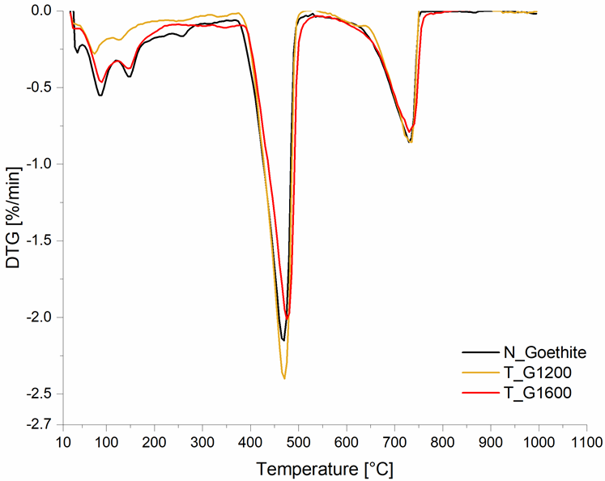
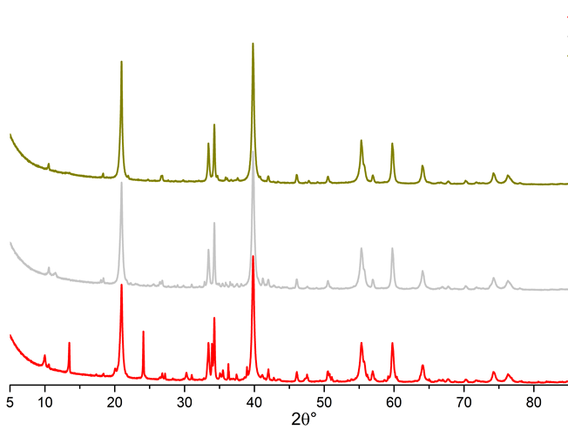
XRD/TGA identification of reaction products
Material | Ettringite | AFm phases | Gypsum | Ca(OH)₂ consumed
Goethite filter cake
GFC | ++ | + |  | +
GFC_T1200 | + |  |  | -
GFC_T1600 | + |  | + | ++
Jarosite filter cake
JFC | ++ |  | ++ | +
JFC_T1200 |  |  | + | +
JFC_L | + | + | + | +
Fayalite slag
FS_T1200 |  |  | + | +
FS_T1600 |  |  | + | ++
FS_B | + | + |  | -
Fe-Ni slag
FNS | ++ |  |  | -

Slide 22
Reaction mechanisms of non-ferrous slags and sludges
Pozzolanic reaction (e.g. GFC_T1600)
  Heat release, Ca(OH)₂ consumption, cement hydrate formation
  (ettringite, AFm, C-S-H)
Hydraulic reaction (e.g. FeNi slag)
  Heat release, little Ca(OH)₂ consumption, cement hydrate formation
Gypsum formation (e.g. JFC)
  Heat release, Ca(OH)₂ consumption, gypsum formation
  Generation of gypsum can lead to internal sulphate attack

Slide 23
Summary and perspectives
A new test method
RILEM TC 267 TRM proposes R3 calorimetry test as reliable and relevant method to measure the reactivity of materials to be used as SCM in blended cements
Reactivity of non-ferrous metallurgy slags and sludges
Pyrometallurgical plasma treatment (reducing atmosphere) is beneficial in terms of SCM reactivity. Extraction of liquid metal at 1600 °C and production of molten slag is most beneficial
Acid leaching and bioleaching reduced suitability to use as SCM
Next steps
Three blended cements are being tested containing FeNi slag and two slags from plasma treatment
The use of the cements in small scale prototypes will be demonstrated
LCA, LCC and market study for the developed products will be carried out

Slide 24
Thank you for your attention!
EUROPEAN UNION
This project has received funding from the European Union’s Horizon 2020 research and innovation programme under grant agreement No 690088.

